Slide 1


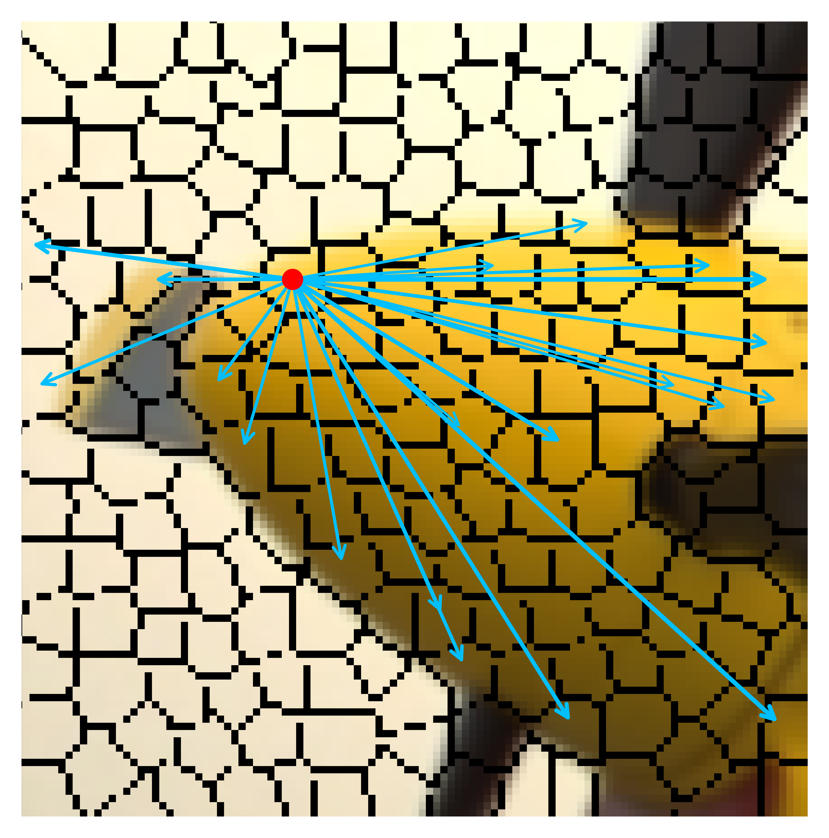
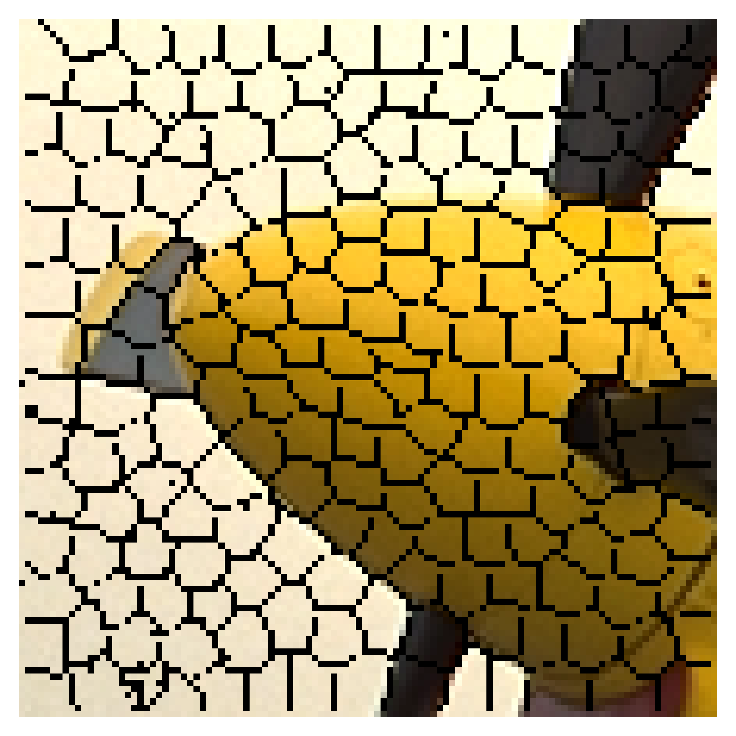
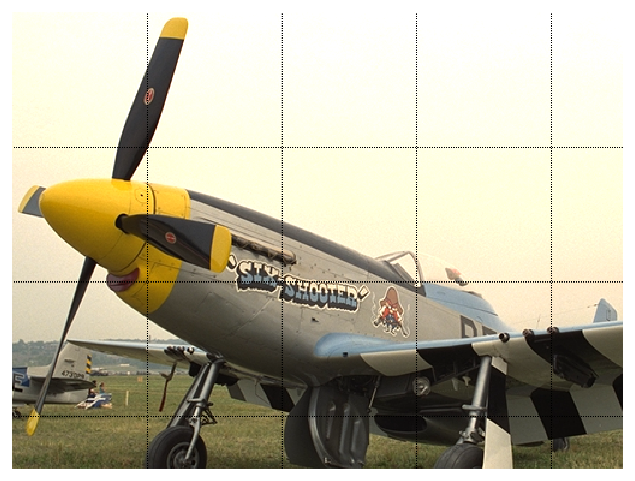

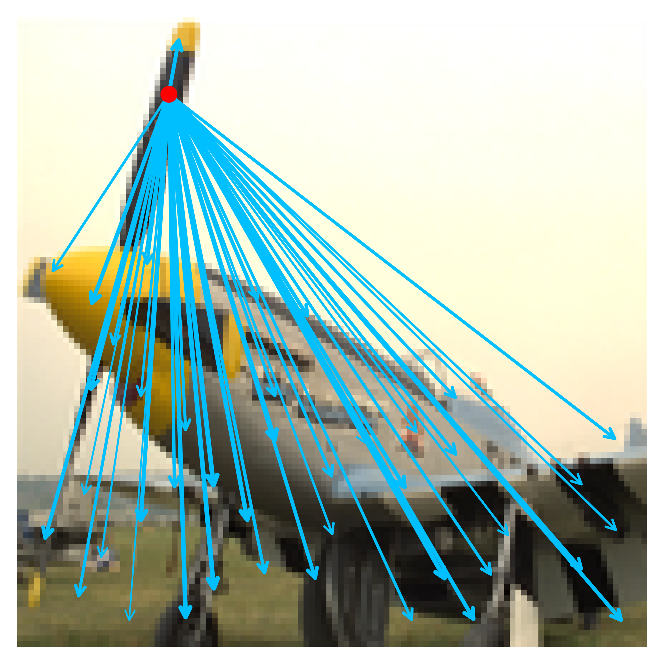
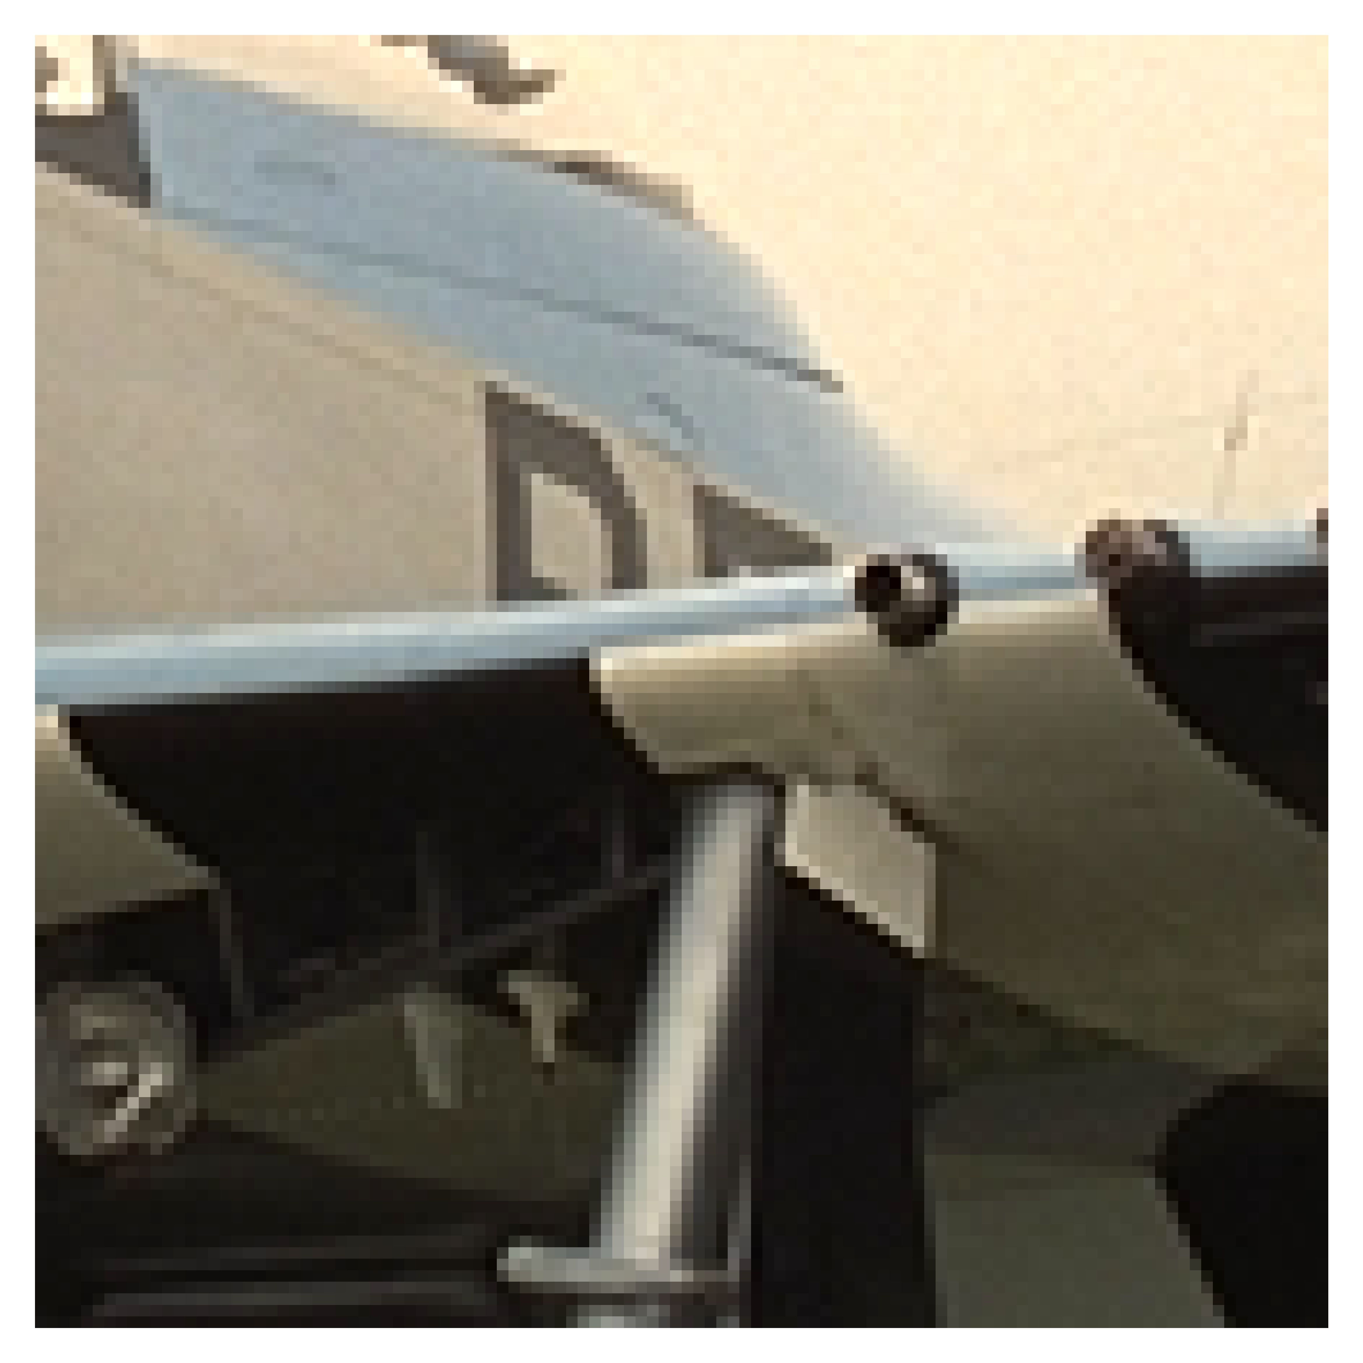
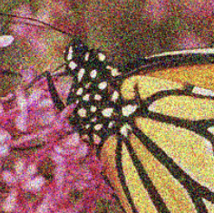
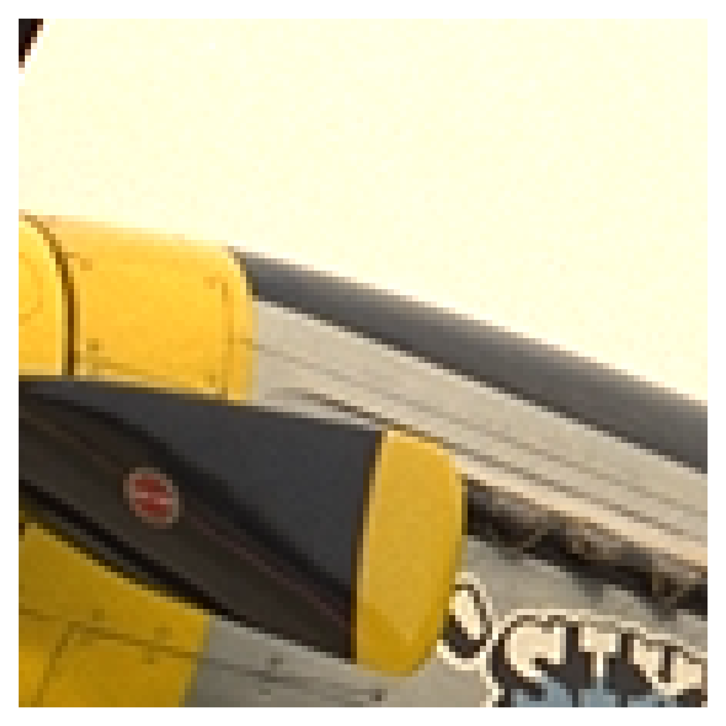
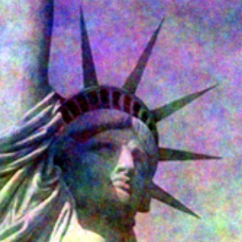
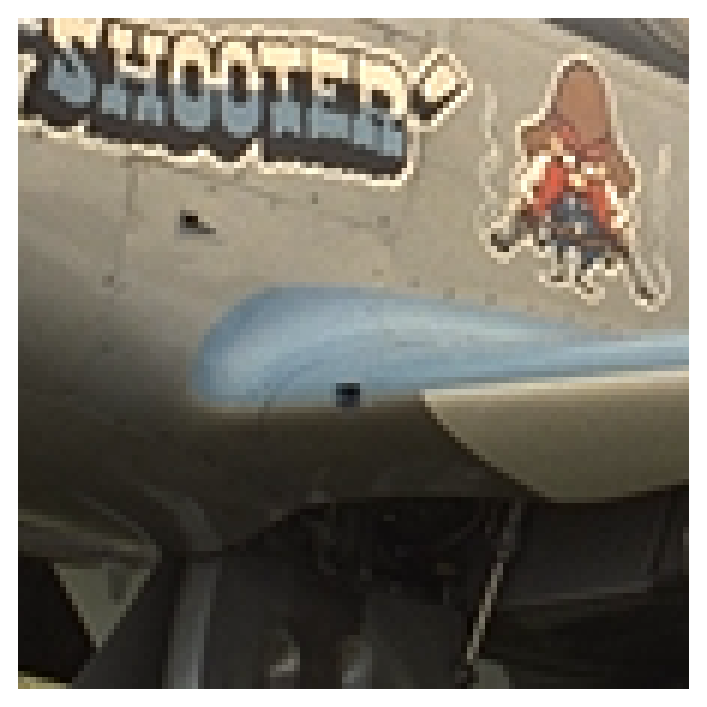
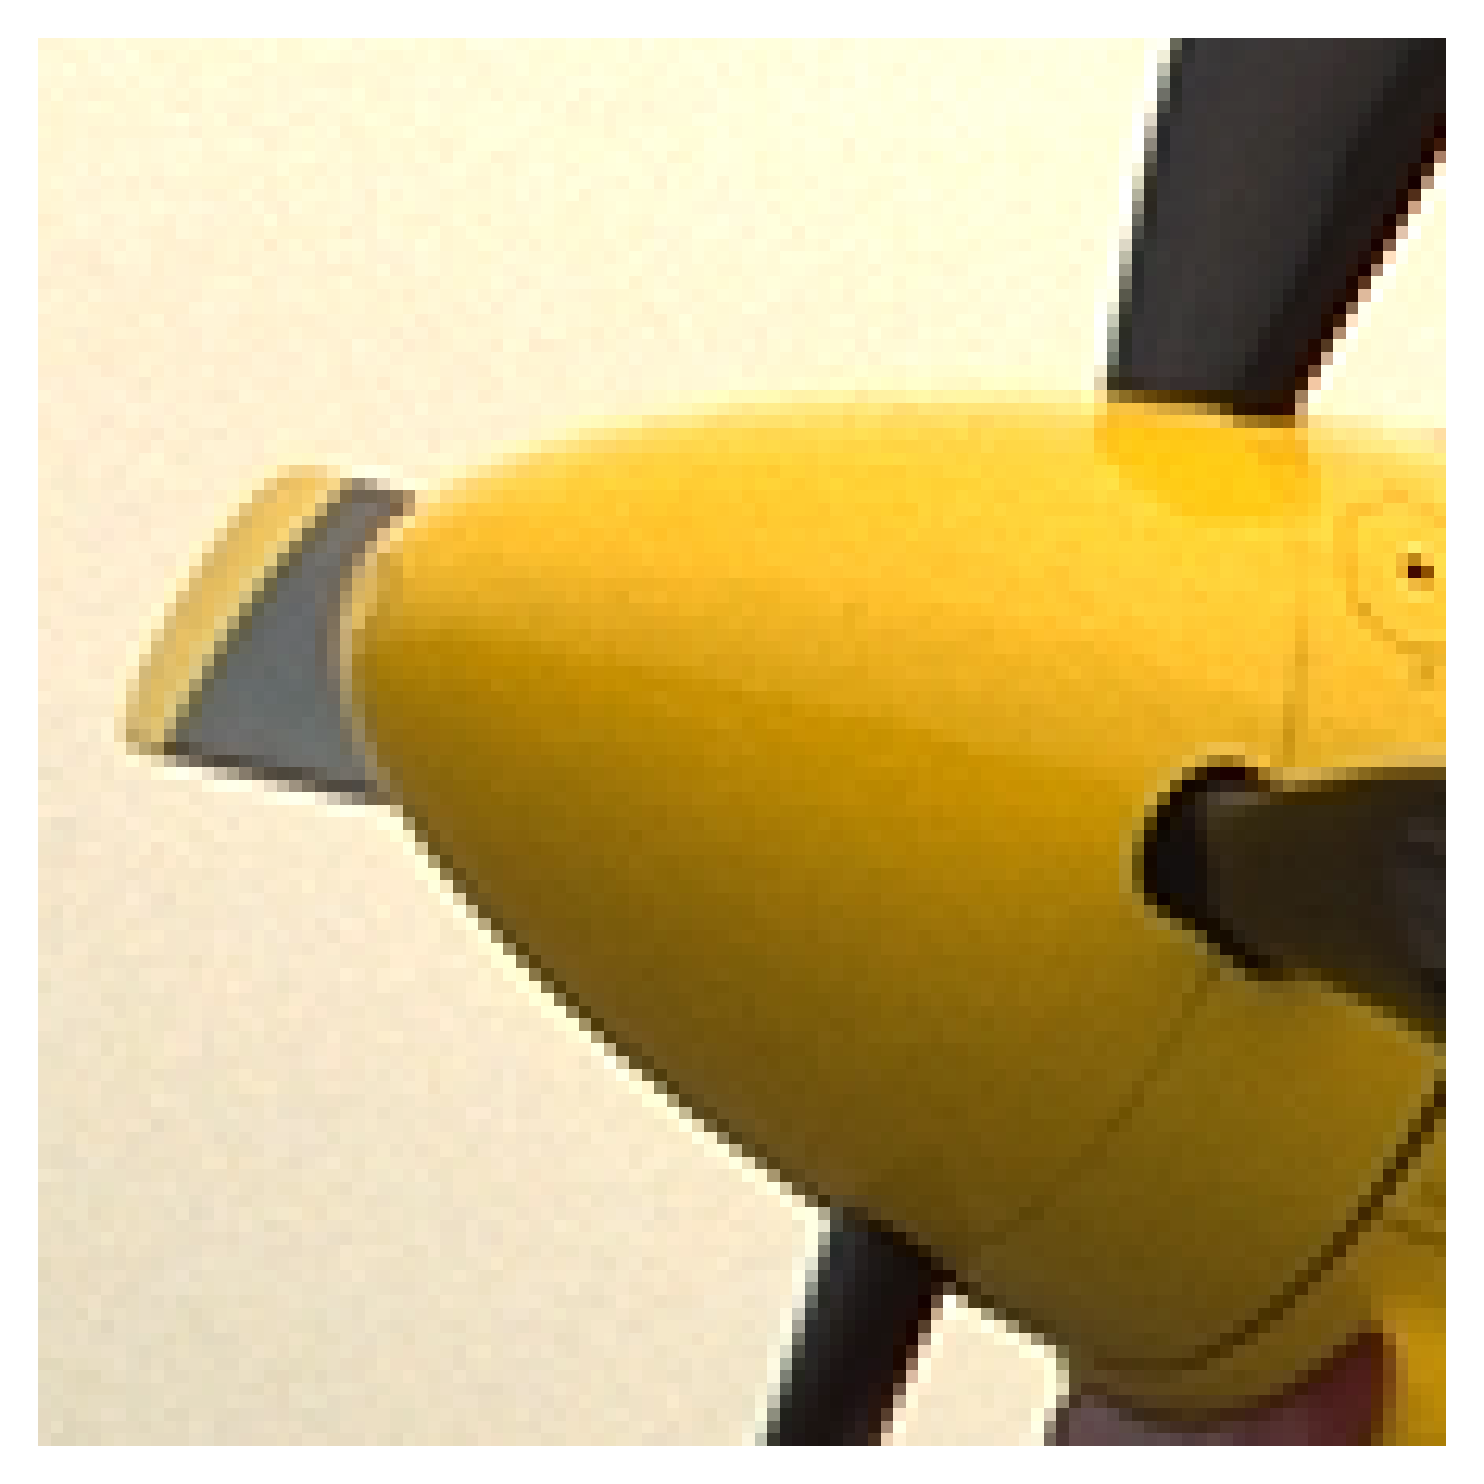
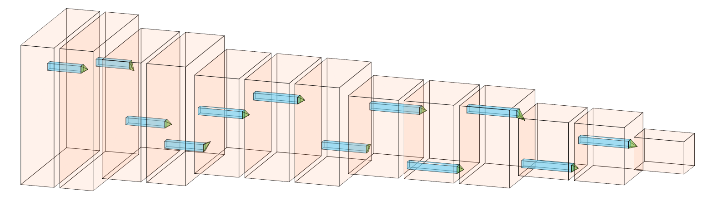
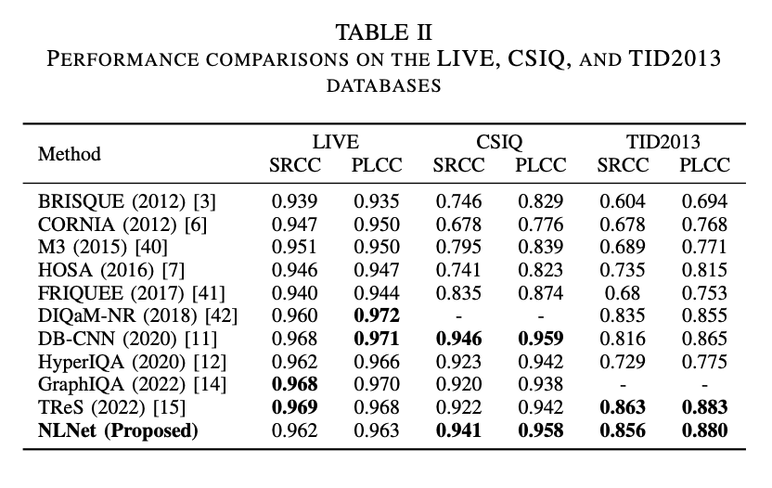
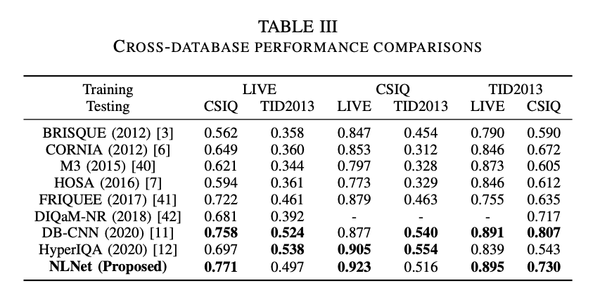
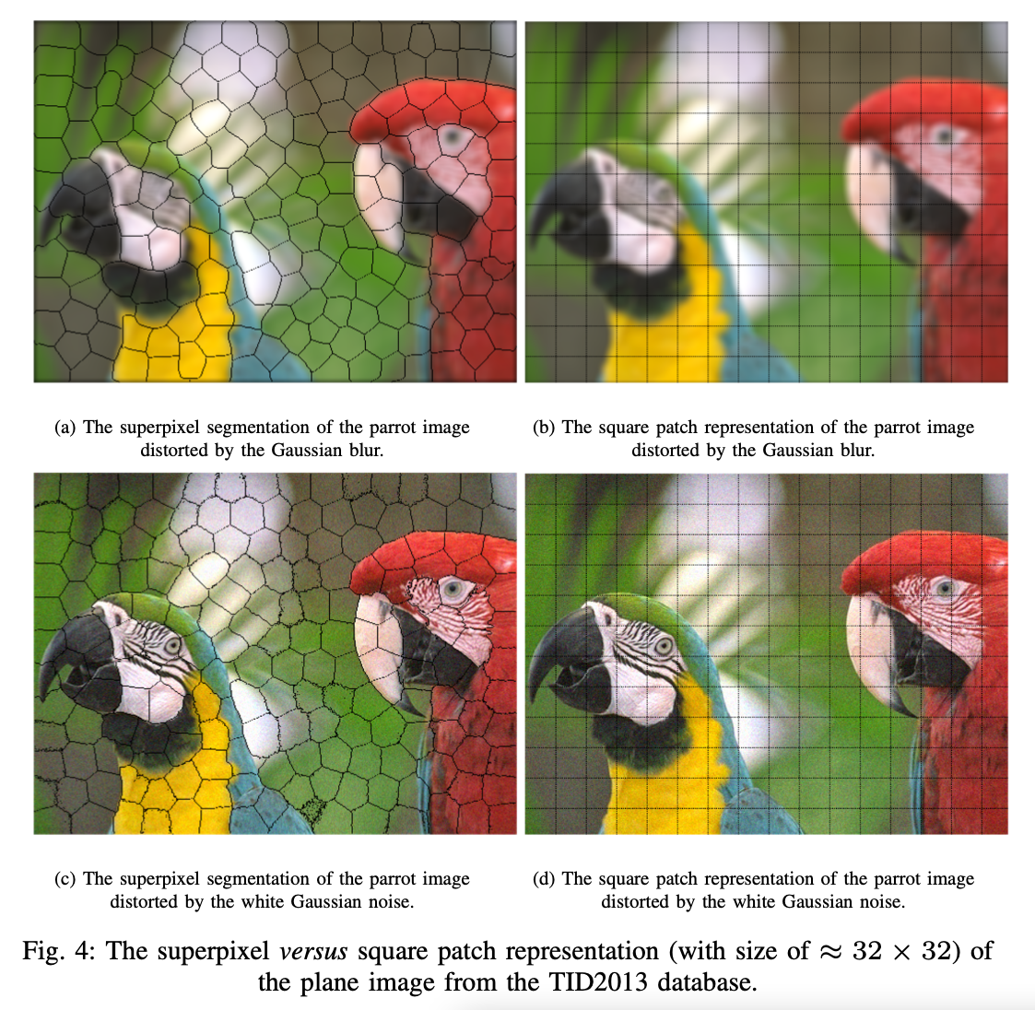
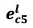
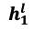
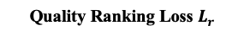
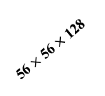
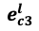
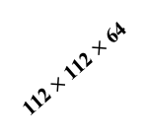
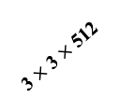
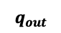
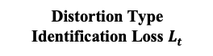
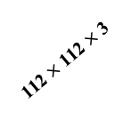
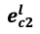
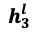
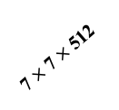
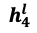
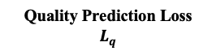
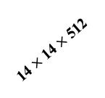
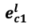
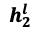
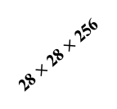
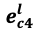
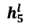
No-reference Image Quality Assessment via Non-local Dependency Modeling
Shuyue Jia¹, Baoliang Chen¹, Dingquan Li², Shiqi Wang¹
¹City University of Hong Kong ²Peng Cheng Laboratory
Background
Image Quality Assessment (IQA): play an indispensable role in improving users’ visual experience and optimizing the production line.
No-reference Image Quality Assessment (NR-IQA): objectively measure the input image quality in the absence of reference images.
Motivation
Human Visual System (HVS) is adaptive to the local content → Local appearance artifacts affect the overall quality.
HVS perceives image quality with long-dependency constructed among different regions → Non-local feature extraction for long-range dependency modeling.
Superpixel
The proposed NLNet
Cosine
$$e_{c5}^{l}$$
$$h_{5}^{l}$$
$$e_{cc}^{l}$$
Stage One:
Local Feature
Aggregation
Similarity
$$h_{4}^{l}$$
$$e_{c4}^{l}$$
$$h_{c}^{l}$$
$$e_{c1}^{l}$$
$$h_{1}^{l}$$
$$h_{3}^{l}$$
$$e_{c3}^{l}$$
$$e_{c2}^{l}$$
Stage Two:
Non-Local Feature
Aggregation
$$h_{2}^{l}$$
Input Patch with
Superpixel Segmentation
(ii) Graph Neural Network – Non-Local Modeling Method
One GNN Layer and the GNN module
Limitations
of Local Modeling Method
Small-sized receptive field → Extracted features are too local.
Parameters fixed across the whole image → Contents are equally treated.
Lack of geometric and relational modeling → Missing complex relations and layouts.
Input
Distortion Type Identification Loss $L_{t}$
(iv) Feature Mean & Std Fusion and Quality Prediction
..
Quality Prediction Loss $L_{q}$
Quality Ranking Loss $L_{r}$
Inference – Final Quality Prediction
query
D
$$1$$
Image Pair
Rank
$$q_{out}$$
global
contexts
FC
512
FC
512
…
…
Average
local region
112 $×$ 112 $×$ 3
The Evaluated Image
112 $×$ 112 $×$ 64
56 $×$ 56 $×$ 128
28 $×$ 28 $×$ 256
(i) Image Preprocessing
14 $×$ 14 $×$ 512
7 $×$ 7 $×$ 512
(a)
Local feature extraction is critical
(b)
Non-local dependency
learned by the NLNet
3 $×$ 3 $×$ 512
Figure 2: Local region feature extraction and non-local dependency feature extraction
Superpixel versus
Square Patch
Adherence to boundaries and visually meaningful.
Accurate feature extraction.
Input Patch
(iii) Pre-trained VGGNet-16 – Local Modeling Method
Conclusion
We propose a novel NR-IQA framework based on the GNN. The non-local behavior of natural images is emphasized and learned in our proposed Non-Local Dependency Network (termed as NLNet).
Extensive experimental results reveal that the proposed NLNet manages to extract the non-local information for quality prediction, and the superior performance in cross-dataset settings verifies the high generalization capability of our proposed method.
Experimental Results
(a)
Superpixel segmentation
(b)
Square patch representation
Figure 1: The superpixel and square patch segmentation of the parrot image distorted by the Gaussian blur.

